Slide 1
PSIT COLLEGE OF ENGINEERING
DEPARTMENT : COMPUTER SCIENCE

Slide 2
FOOD ORDERING WEBSITE : FOODIE
SUBMITTED BY : ARADHYA (1903480100027) , SHRISHTI BANDEJIYA (1903480100101)
SUBMITTED TO : AMIT KUMAR RAI

Slide 3
TABLE OF CONTENT
INTRODUCTION
FUTURE SCOPE
PROBLEM IN THE EXISTING SYSTEM
REQUIRMENTS
WEB ORDERING SYSTEM MODULE
FUTURE WORKS
REFERENCE
CONCLUSION
THANK YOU

Slide 4
INTRODUCTION
ONLINE FOOD ORDERING IS THE PROCESS OF ORDERING FROM A WEBSITE OR OTHER APPLICATION . THE PRODUCT CAN BE EITHER
READY -TO- EAT FOOD ( E.G., RESTAURANT OR A GHOST KITCHEN ) OR FOOD THAT HAS NOT BEEN SPECIALLY PREPARED FOR DIRECTION CONSUMPTION ( E.G., VEGETABLE DIRECT FROM FARM OR MEATS ETC...) .

Slide 5
FUTURE SCOPE
DRIVE SALES WITH SOCIAL MEDIA
MOBILITY AND EASE
PHONE ORDERS OUTSTRIPPED
HOME DELIVERIES INCRESED
FOOD PREORDERING USING RESTAURANT APP
PRICE DROP

Slide 6
PROBLEM IN EXISTING SYSTEM
IN PRESENT SCENARIO , PEOPLE HAVE TO PHYSICALLY VISIT THE HOTEL .
IN THIS METHOD , TIME AND PHYSICAL WORK IS REQUIRED .
THE TRADITIONAL FOOD ORDERING SYSTEM IS NOT EFFICIENT ENOUGH FOR HOTELS AND RESTAURENTS .
THE TRADITIONAL ORDERING SYSTEM IS QUITE CUMBERSOME AND TENDIOUS WORK TO DO FROM THE OWNER POINT OF VIEW SINCE IT IS REQUIRED PHYSICAL FILE WHICH IS RISKY ALSO.

Slide 7
REQUIRMENT
HARDWARE REQUIRMENT :
PROCESSOR - ATLEAST 2.0 GHZ
RAM - ATLEAST 2 GB
SOFTWARE REQUIRMENT :
BACK END - Php
FRONT END - HTML , CSS
EDITOR TOOLS - ATOMS
WEB BROWSER - GOOGLE CHROME , FIREFOX , OR ANY COMPATIBLE UPDATED BROWSER

Slide 8
WEB ORDERING SYSTEM MODULE
THIS MODULE PROVIDE THE FUNTIONALITY FOR CUSTOMERS TO PLACE THEIR ORDER AND SUPPLY NECESSARY DETAILS . USERS OF THE SYSTEM , NAMELY RESTAURENT COUSTEMERS , MUST BE PROVIDED THE FOLLOWING FUNTIONALITY :
CREATE AN ACCOUNT
MANAGE THEIR ACCOUNT
LOG IN TO THE ACCOUNT
NAVIGATE THE RESTAURENT MENU
PLACE AN ORDER

Slide 9
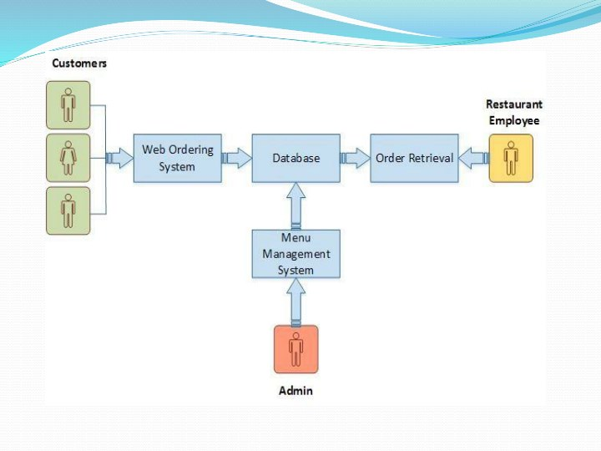
FLOWCHART

Slide 10
WEB ORDERING SYSTEM - THE FUNTIONALITY FOR CUSTOMERS TO PLACE THEIR ORDER AND SUPPLY NECESSARY DETAILS .
MENU MANAGEMENT - ALLOW THE RESTAURENT TO CONTROL WHAT CAN BE ORDERED BY THE CUSTOMERS .
ORDER RETRIEVAL SYSTEM - THIS IS A FINAL LOGICAL COMPONENT . ALLOWS RESTAURENT TO KEEP TRACK OF ALL ORDERS PLACED . THIS COMPONENT TAKE CARE OF ORDER RETRIEVING AND DISPLAYING ORDER INFORMATION.

Slide 11
FUTURE WORKS
THE FOLLOWING SECTION DESCRIBE THE WORK THAT WILL BE IMPLEMENTED WITH FUTURE RELEASES OF THE SOFTWARE :
CUSTOMIZE ORDERS
ENHANCE USER INTERFACE BY ADDING MORE USER INTERACTIVE FEATURES
PAYMENT OPTIONS
DELIVERY OPTIONS
ORDER PROPCESS ESTIMATE
ORDER STATUS
ORDER READY NOTIFICATION

Slide 12
CONCLUSION
Finally, in Online Food Ordering system, we have developed secure, user-friendly food ordering Management System. This System can take care of each member whether it is an Administrator or Customer.This System is completely secure. Using this system will help in reducing the labour and provide more facility for Customer to like the services.

Slide 13
REFERENCE
https://www.slideshare.net/armanreza161/food-order
https://www.slideserve.com/binshiya/restaurant-online-food-order
https://www.google.com/url?sa=i&url=https%3A%2F%2Fscholarworks.gvsu.edu%2Fcgi%2Fviewcontent.cgi%3Farticle%3D1222%26context%3Dcistechlib&psig=AOvVaw0EGbKme09wnJKR96fSnQHc&ust=1610867157792000&source=images&cd=vfe&ved=0CAIQjRxqFwoTCLjvxfjxn-4CFQAAAAAdAAAAABAD

Slide 14


